Slide 1

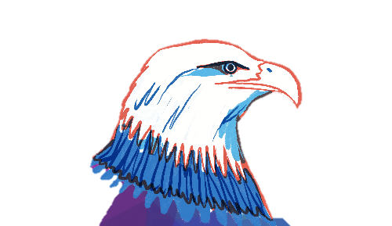
Basic Details of the Team and Problem Statement
Problem Statement By: Ministry of Home Affairs​
PS Code: 1439​
Problem Statement Title: Robotic Device for Borewell Rescue System​
Team Name: The Eagle Eye​
Team Leader Name: Harsh Vardhana
Institute Code: U-0840​
Institute Name: Indian Institute of Information Technology, Ranchi​
Theme Name: Disaster Management​
THE EAGLE EYE

Slide 2
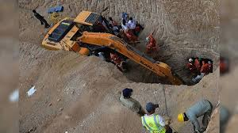
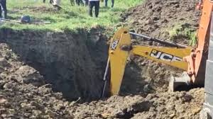
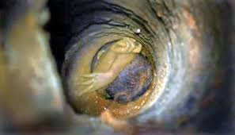
PROBLEM
India has over 27 million borewells, of which several are dried up and no longer in use.
In such a situation, usually, the pipe and the iron cast are removed, leaving behind an open hole. They are removed to show that the well is no longer useful.
According to the National Disaster Response Force (NDRF), since 2009, over 40 children have died after falling into borewells and over 70 % of rescue operations failed.

Slide 3
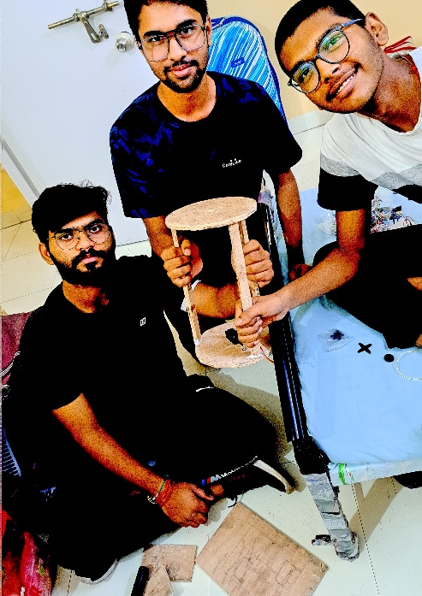
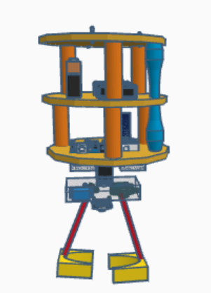
Show Stoppers
Below a hard deck of 100 - 200ft the basic requirement for the victim is oxygen. We installed an OXYGEN CYLINDER which flushes in the oxygen when it is sent down.
We have a two way communication device which enable us to communicate with the victim.
Can be operated by any person, regardless of their technical skills.
Technological Stack
Arduino Programming (Cpp)
Serial Monitor
Various Sensor and Motors (ESP32 CAM, HC05, 995R)
Basic Concepts of Mechanical Engg.
Virtual design of the Finished Machine

Slide 4





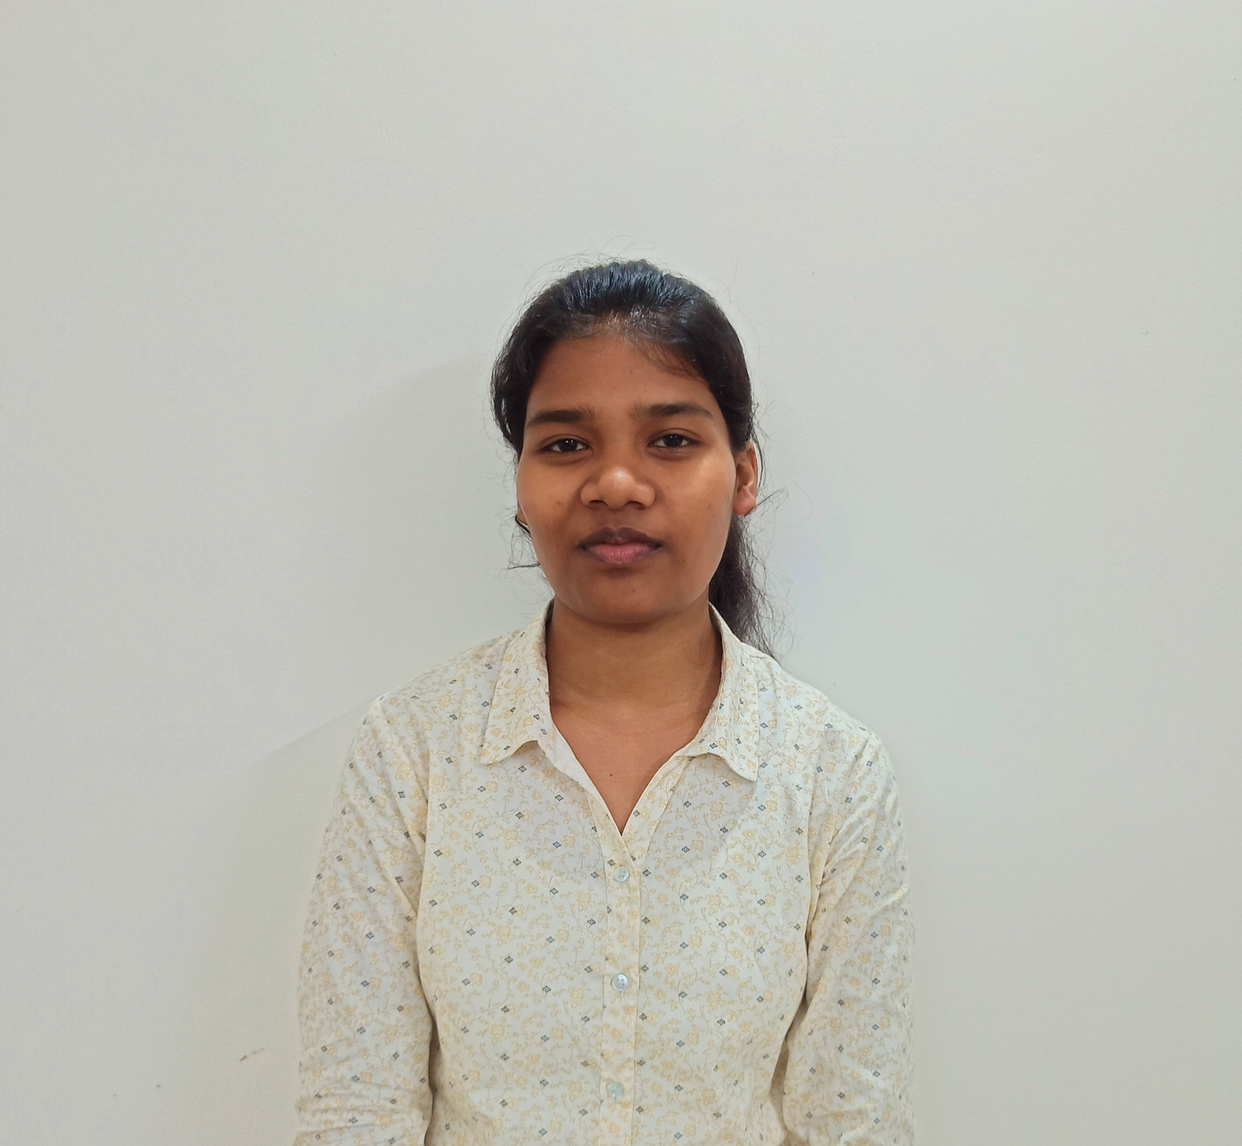
COURSE: B.Tech
NAME: HARSH VARDHANA
BRANCH: ECE
YEAR: II
COURSE: B.Tech
NAME: ADITYA KHULLAR
BRANCH: ECE
YEAR: II
COURSE: B.Tech
NAME: NAVEEN KUMAR GUPTA
BRANCH: ECE
YEAR: II
COURSE: B.Tech
NAME: SHIVAM VERMA
BRANCH: ECE
YEAR: II
COURSE: B.Tech
NAME: KASTURI MARANDI
BRANCH: CSE
YEAR: I
COURSE: B.Tech
NAME: AMIT KUMAR
BRANCH: ECE
YEAR: II

